Slide 1
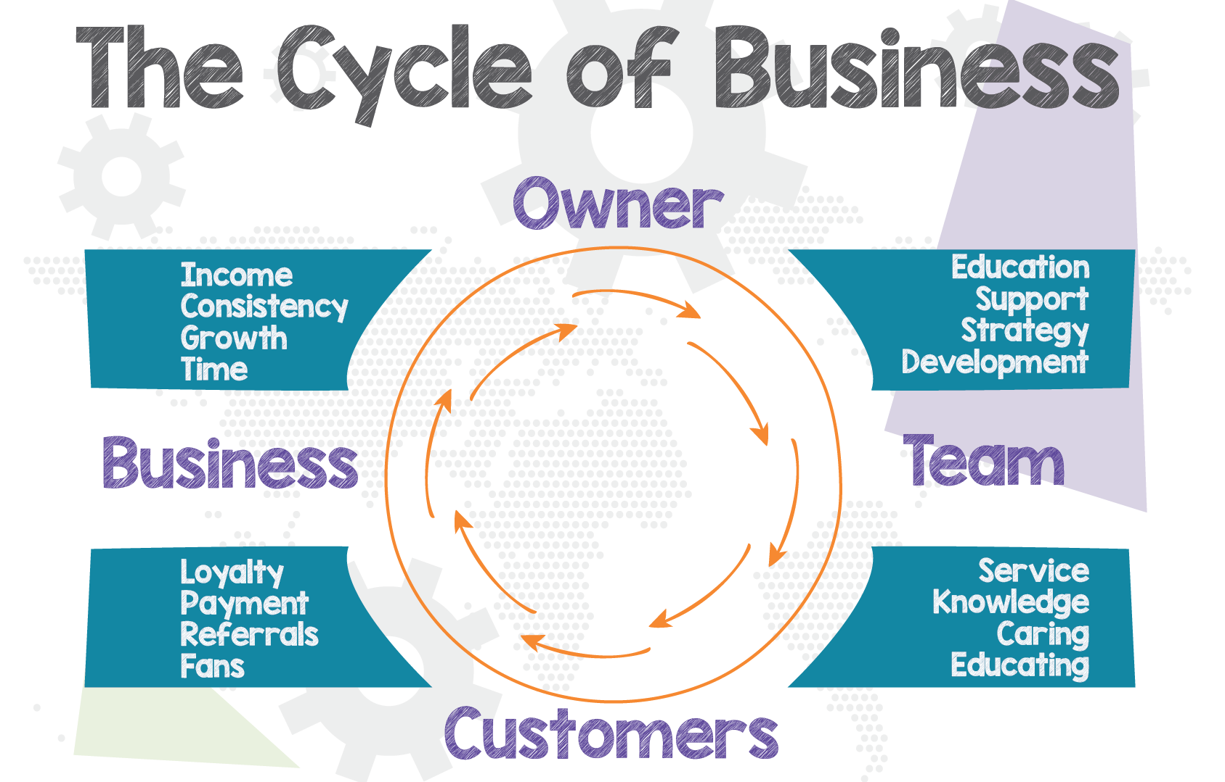
Manufacturing Mission, Vision, Values ...
what’s the purpose?
11:00pm 13th July 2022
Future Webinars
07/09 Manufacturing your ideal client | 26/10 Manufacturing and improving effective systems | 14/12 Manufacturing tools for getting stuff done

Slide 2
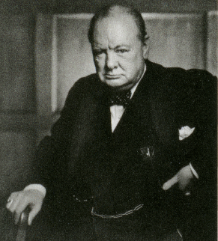
Notes:
Good morning... Great Britain watched in horror as the continent was subject to the tyranny of Nazi Blitzkrieg raids.... Churchill galvanised the people of Britain to prepare for their greatest hour.

Slide 3
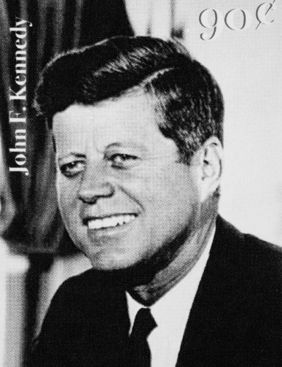
Notes:
… In October 1957 the Americans looked up to find a Soviet Union Sputnik Satellite in space … Russia their enemy … was winning the space race … there was a crisis … of confidence if nothing else… Their response? ... Kennedy committed to put an American on the moon…with the immortal line not because it was easy but because it was hard. They didn’t know it could be done nor how much it would cost.

Slide 4
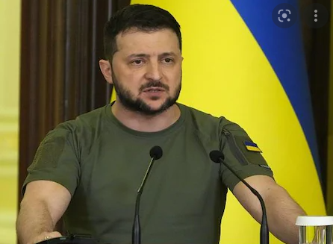
Notes:
More recently this top man... Who I'm pretty confident ... Most of us would know pretty much nothing about ... if it wasn't for recent events ... has risen to similar challenges ... and echoed the words of both Kennedy and Churchill
All of them faced threats that have terrified and electrified them. ... those same threats have also worked to galvanise them, as their people work to focus on a shared endeavour... a shared vision… that gave meaning to their lives ...
Good morning … Thank you for joining me on todays constructing mission, vision and values… what’s the purpose? webinar … the third in the cycle of business series … each of which has been developed with the objective of helping ambitious owners and managers drive their construction company forward …
….My name is mark woods …. I am a director of Statius …. And

Slide 5
Vision – To create joy in work & joy in learning for UK SMEs
Mission - Helping ambitious owners become great leaders by delivering
Notes:
… our mission is to help ambitious owners become great leaders …we want to help them and their team… improve the way in which their work works
…And to accommodate that ... As we work through this webinar .... and the series ...we will provide you with hopefully valuable collateral ... “How to” booklets, checklists, templates, examples, questionnaires ... Some of which we will work through during the webinar... All of which are detailed in our resources booklet which we will make available at the end of this webinar...
And we believe the things we do... should act as a lubricant….we want to work with you to improve ... and smooth .... how your work works … we want to help you generate and deliver ...
Better strategies … Better systems… Better measurement …my favourite bit
Engaged people delivering …the bit you are actually interested in…
The better results ..... So.. Who have we worked for ...what’s our credibility....

Slide 6
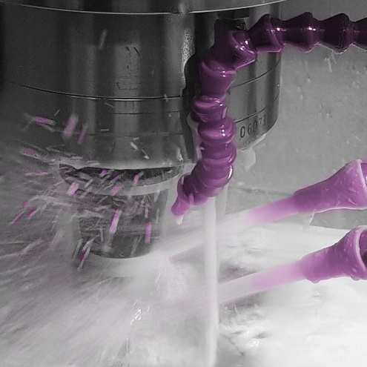
Clients
Notes:
Interestingly or perhaps otherwise …Most of use are engineers in one form or another some are even , like me apprentice served..... All be it some many years ago....it’s a long time since I have picked up a spanner or programmed a CNC machine ... I hve more recently developed a manufacturing strategy ..... Anyway .... we’ve worked with both large and small manufacturing companies for nearly 30 years
Some of the big guys include GEA an international engineering company …Schwing Stetter a manufacturer of construction pumping solutions, or the Vita Group specializing on foam solutions and products
But our core customer base is

Slide 7
Clients
Notes:
Owner managed companies like Hunton and John Mays ... subcontract engineering companies ... UK exchanges Manufacturers of heat exchanges or I abra designers and manufacturers of some pretty cool medical device stuff ...
Essentially, .... our ideal client ... a subject we will be covering as part of the series in detail later ...are ambitious construction company owners and managers that want to grow themselves and their team ...
So... What’s the agenda?

Slide 8
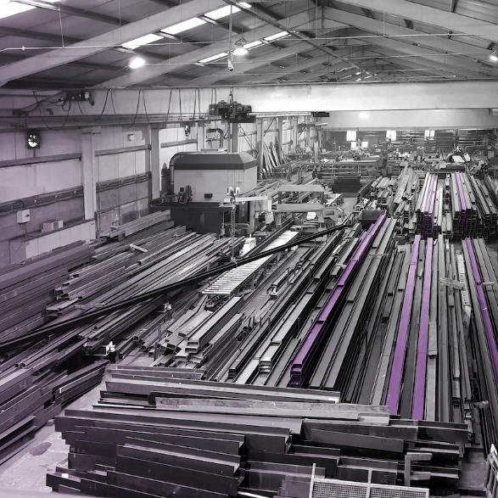
Agenda
The current situation
Profit v Purpose
Vision
Mission
Values
Purpose
Where do you start?
Notes:
We are going to talk about
The construction current situation
Profit v Purpose
Vision
Mission
Values
Purpose
Where do you start?
…so first the current situation for construction

Slide 9
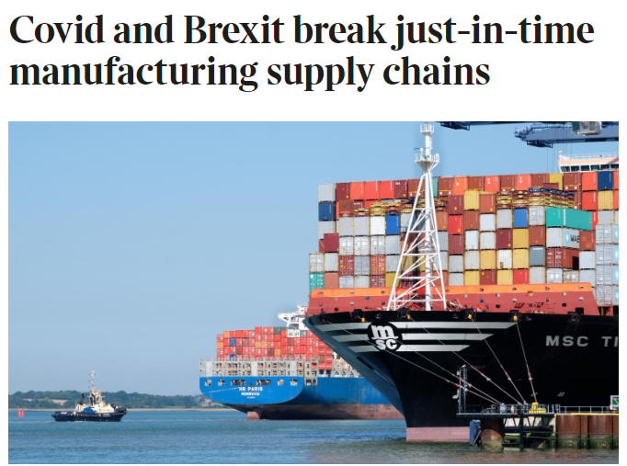
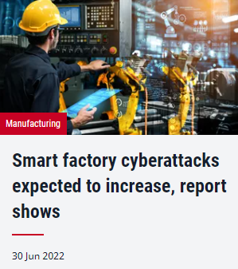
The current situation
Notes:
These are just a few storoes taken from the FT, the Times, The engineer and the manufacturer
Labour is a problem, factory growth is reported as being at its weakest for years, ... Clearly materials and their supply are an issue as are any other number of things ... we've also got the impact of the disarray caused by our glorious government ...but these are all external influences which critically influence how you make decisions ...But added to these they might be internal issues to address...
Processes insufficiently defined or robust to get estimates out of the door or indeed the job done ...on time
Problems with getting money in ...Problems with people and staff
but ...equally... there are also opportunities ...

Slide 10
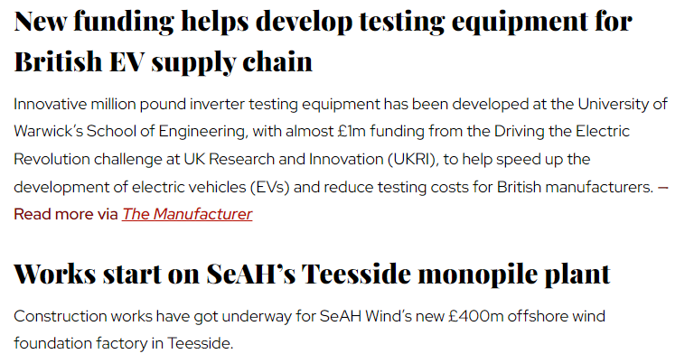
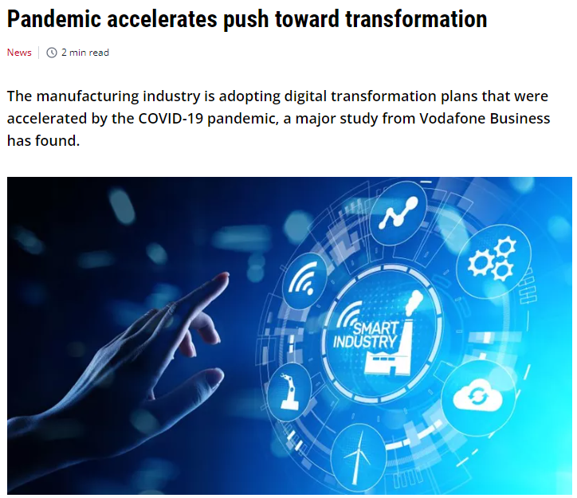
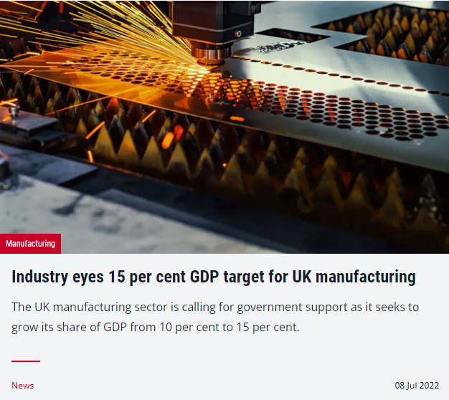
The current situation
Notes:
The manufacturer reports funding help for the EV supply chain. The engineer reports manufacturing eying a rise in manufacturing to 15% of GDP as well as reports pushing the positive effects of digital transformation
So, given these types of internal and external issues .... the legitimate question is how can these “big company things” things like mission, vision, values and purpose assist with these issues?

Slide 11
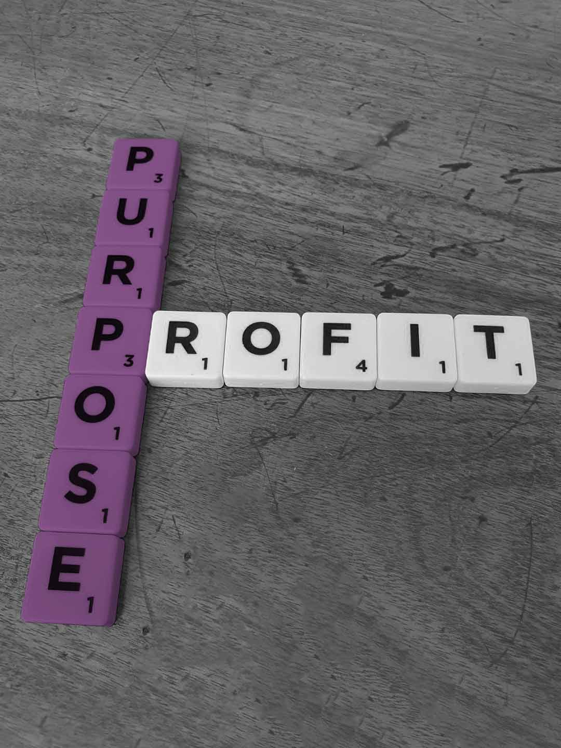
Profit verses Purpose
Notes:
When we ask, as we sometimes do, what’s the purpose of an organisation? The first answer we usually get is to make a profit.... or in the corporate world to deliver shareholder returns …indeed it’s the carved in stone mantra of business schools …
Obviously, profit is necessary for organisational survival. But making a profit should not be confused with an organisation’s purpose.
Just as breathing air is necessary for each of us to survive, we can’t assume that breathing air is our purpose. Air is to a human as profit…. (or probably more accurately …. cash flow) is to a business.
When we talk about Purpose we can inspire people …when we talk about profit we’ll invariably turn … most of our people … off
There is a great systems thinker, a guy called Russ Ackoff …he offered that the purpose of an organisation lies in DEVELOPMENT. Development of products and services, development of worker skills and understanding, development of a market, development of infrastructure, development of the community.
As we know …

Slide 12
Notes:
Many organisations publish their mission, vision and values statements .... but what is the purpose?
The question above is actually two questions:
1. The obvious one of “what is the purpose of a mission, vision and values statements?”
The second is perhaps more interesting:
2. What is the “purpose” of an organisation and how does this differ from mission, vision and values?
That's the focus of this session ... so let's look at them one at a time ... But before we do so...

Slide 13
Notes:
The trick here, I think is to begin.... with the end in mind
As I understand it JK Rolling started writing the Harry Potter series, of ...i think... six books, knowing what the last line in the last book would be…
…that’s a blistering example of starting with the end in mind.
The point is if you start with the end in mind you can work back, to see what you need to do for each period, be it year, quarter, month or week
And a bit like an airline pilot or a ships captain .... the destination is known but they actually crisscross the perfect course for the entire duration of their journey ...It's only when they criss cross that perfect line that they are on course... 99% of the time they are not ...

Slide 14
Vision
Mission
Values
Notes:
So …. at this point lets first define and flesh out what we mean by some of these terms

Slide 15
Vision
Notes:
Vision: The vision is About your future .. Perhaps your end point… it’s the last line in the last Harry Potter book …it’s your destination, it’s the aspiration, it’s future focused and usually describes where you want to get to and what success will look like.
Some describe the vision statement as your big hairy audacious goal ...which I think is a Jim Collins term, he's the guy of Good to Great fame ...

Slide 16
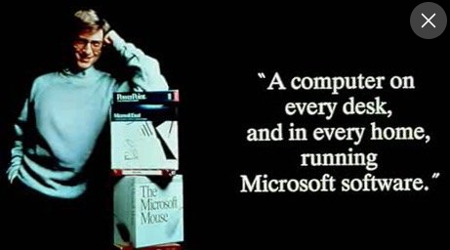
Vision
Notes:
The archetypal vision statement is probably Bill Gates when he said in the 80’s I want a computer on every desk ... and in every home ... Running Microsoft software ... others might include

Slide 17
Vision
Oxfam – A just world without poverty
Ikea – To create a better everyday life for the many people
Tesla – to accelerate the worlds transition to sustainable energy
Notes:
Oxfam – A just world ... without poverty ... Ikea’s is To create a better everyday life for the many people
Finally using a construction company example ....Wates is .... together we inspire better ways of creating the places, communities and businesses of tomorrow.
So what’s a mission statement ... AND HOW IS THAT DIFFERENT?

Slide 18
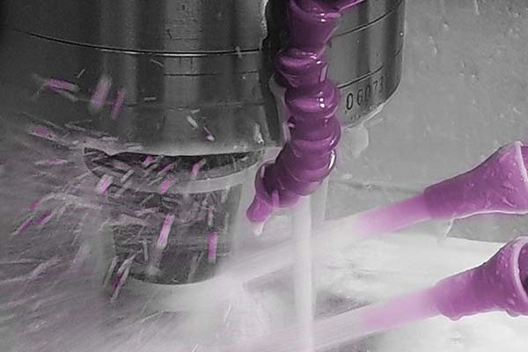
Mission
Notes:
Mission: The mission statement is your vehicle, it’s the perspiration, it’s focused on the here and now, it usually describes what you do ... and what you get paid for and it often attempts to set you apart from your competitors. Wikipedia cites a guy called Vern McGinis, who suggests “a mission should:

Slide 19
Mission
Define what the company is
Exclude some activities
Allow for growth
Distinguish the company from competitors
Provide a framework to assess activities
Understood by all
Notes:
Define what the company is ....and is not ... about ... As a result it could exclude some ventures or activities
It needs to be broad enough to allow for future growth and development... You don't want it to constrain potential lucrative areas of development
It need to set you apart ... to distinguish you ... from your competitors... in some way
It can ...and should ... serve as framework to evaluate current activities
And it should be clear and understood by everyone
Ultimately, your mission statement seeks to justify your organization's reason for existing”
Again.... Let's have a look at a couple of examples ...

Slide 20
Mission
Coca-Cola – To refresh the world
TED – Spread ideas
Ferrari - To make unique sports cars that represent the finest in Italian design and craftsmanship, both on the track and on the road.
Notes:
Coca-Cola’s is to refresh the world... How simple is that? TED’s is even simpler – Spread ideas
Tesla’s is – to accelerate the worlds transition to sustainable energy
... One construction company we worked with defined theirs as being “we build communities people want to call home”
Vision statements are about the future and what you want to become ... Mission statements are much more focused on what It is you currently do...
let's now take a peek at HOW ...those things are done”

Slide 21
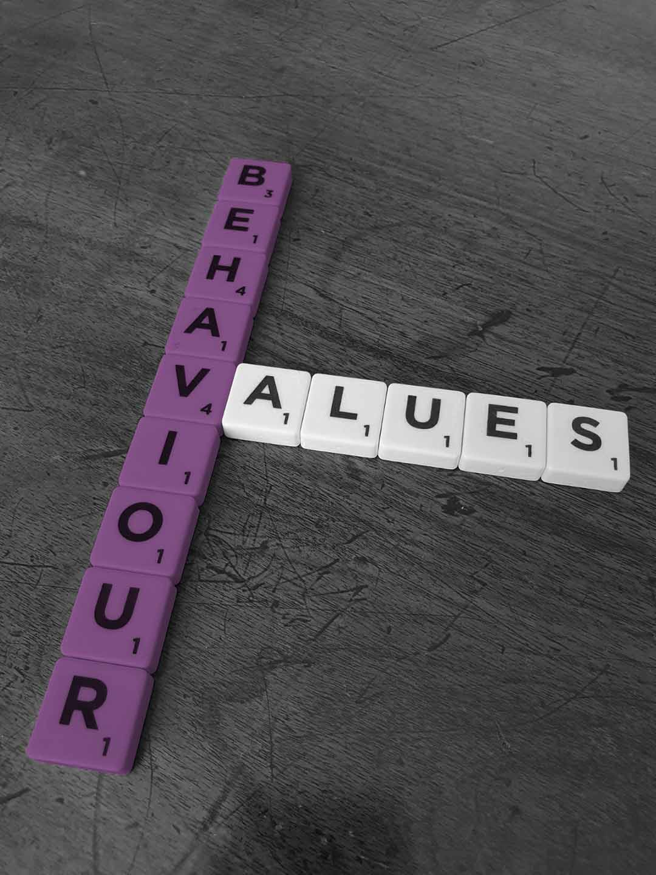
Values
…values are “the principles that guide behaviour...”
Notes:
Values: Values statements serve as a frame work to guide the daily actions, decisions and behaviours.... they represent the standards by which staff will be measured.... Most organisations will, understandably, be committed to achieving their goals, but how they go about achieving them is equally...., if not more important, than the mission and vision themselves. A company’s values are “The principles that guide behaviour at work.”
A core set of company values makes it easier for a company to make decisions, quickly communicate principles to clients and customers and hire people with the right attitude.
Creating a business is a bit like creating a community and if you want the community to act cohesively, you need a shared ethos that drives how the community functions and helps you to choose who to invite into... your community.
Conversely, if you don’t own, define, and care about the values of your firm, your firm will evolve on its own…potentially, in ways that you won’t like! So, defining values is important because they provide guidance for ambiguous scenarios and tough trade-offs.
Values should be the touchstone that guides behaviour.

Slide 22
Values
Nouns
Verbs
Source: Simon Sinek
Notes:
How you do things manifests in the systems and processes you develop to execute the task necessary to deliver value to you clients …its about the culture within an organisation… how you do things and… more importantly … having the discipline to hold the organisation .... and your people .... to those guiding principles …
However, values …in many cases are still set down as nouns… honesty, integrity, innovative… There is a guy called Simon Sinek...

Slide 23
Nouns v verbs
Honesty
Integrity
Innovative ……………
Excellence …………..
Respect
We’ll tell you the truth
We’ll do the right thing
We look at things from a different angle
We want you to do you best
We treat people with care
Notes:
… he suggests, in his book “Start with Why” .... and I agree, that nouns are not actionable … telling people to have integrity does not guarantee that their decisions will always keep the customers best interests at heart. Telling them to always do the right things does
Here we’ve put few nouns v verbs values on this slide … these are our version of what they might look like…they don’t have to be yours and there are others in the “how to” booklet accompanying this webinar which will be downloadable from the link you’ll be sent
But ... the attentive amongst you will not have forgotten that my original question was …what’s the purpose?

Slide 24
Notes:
But ... the attentive amongst you will not have forgotten that my original question was …what’s the purpose?
Companies are born, survive, and thrive because there is a group of people…customers… willing to continue to pay them for what they do. These customers get some benefit or capability from the products and services provided
Consequently, the objectives of a purpose statement are twofold:
One….to … Provide a goal for the operational processes that deliver value … (benefits and capabilities)… to the customer.
Because.... Astonishingly...there is no reference to the customer in the majority of vision, mission and values statements
Two …to … Unleash innovation in order to better deliver those benefits and capabilities that your customers want
Returning to our friend Mr Sinek... check out his you tube video’s...

Slide 25
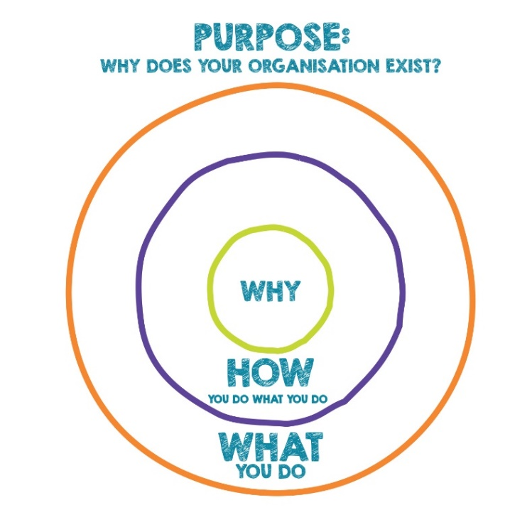
What
Every organisation on the planet knows WHAT they do. These are the products they sell or the services they offer
How
Some organisations know HOW they do it. These are the things that make them special or set them apart from the competition
Why
Very few organisations know WHY they do what they do. WHY is not about making money. That’s the result. WHY is a purpose, cause or belief. It’s the very reason your organisation exists.
Source: Simon Sinek
Notes:
He suggests that all inspiring leaders think the same way, all he did was codify how ….and he’s called it the golden circle… He suggests, it’s the difference between why some companies inspire and others don’t… Most of us communicate from the outside in, the clearest thing to the fuzziest thing. However, he is suggesting inspired leaders think, act and communicate from the inside out, he comments that …
all organisations know what they do
some know how they do it
very few know why …
So, if you can get to the why… that is the purpose of the organisation and communicate it ….where the purpose is defined as benefits and the capabilities that are delivered to your customers and clients .... the better you can engage with them .... and your people.
The power behind this “inside out idea” …. why first ….what last …replicates how our brains work, so because of this we get much more of an emotional engagement, as concentrating on why takes us to a point where we are no longer concentrating on “selling products and services” .... instead we are helping to solve a problem….your clients problem

Slide 26
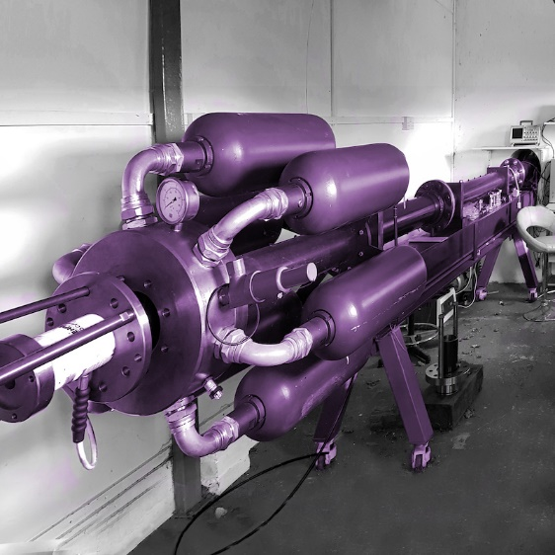
Purpose
Notes:
The organisations purpose is often quiet a hard one for people to get their head around …. as we usually take the business school mantra that the purpose is profit, money cash in the bank… these are key… critical even… but …as already noted they are the result of delivering good products and services to customers.
Now lets look at a few examples detailing the difference between the things organisations do … the what … and their potential purposes…the why

Slide 27
Purpose
Notes:
What is done at school is they teach kids ….their “why” might more accurately be described as inspiring a quest for life long learning…or perhaps to help each child find their passion
A library loans books but their why might be something about satisfying the desire for literature or learning
A security company provides security services but their why is something about the protection of people and assets
Taking a couple of more notable examples
Kodak made camera’s and film …but the benefits and capabilities they delivered was something around capturing and sharing memories
Blockbuster video, once on every high street corner rented video’s and DVD’s …but the benefits and capabilities they delivered was about getting entertainment and education into their clients home at a time of their choosing …these days it’s less about the home and more about a platform of their choosing…
Once you have identified the benefit and capabilities you deliver to your clients, everything stems from there, your key processes… should be aligned to that purpose… if you do that you stand less chance of missing market and technology shifts… Like Kodak, the Blockbuster Goliath got taken out by the Netflix David simply because it did not properly articulate, or concentrate on, the benefits and capabilities delivered to its clients – its purpose.
Once you have identified the benefit and capabilities you deliver to your clients and following a bit of word smithing like Kennedy and like Churchill you can engage and inspire your people …
Incidentally, just so you know that we have thought about it our why … our purpose …. is to help you deliver Better strategies, better systems, better measurement (KPI’s) and engaged people delivering the all important…better results.
...our purpose is about you... our clients and the benefits you get from our services...

Slide 28
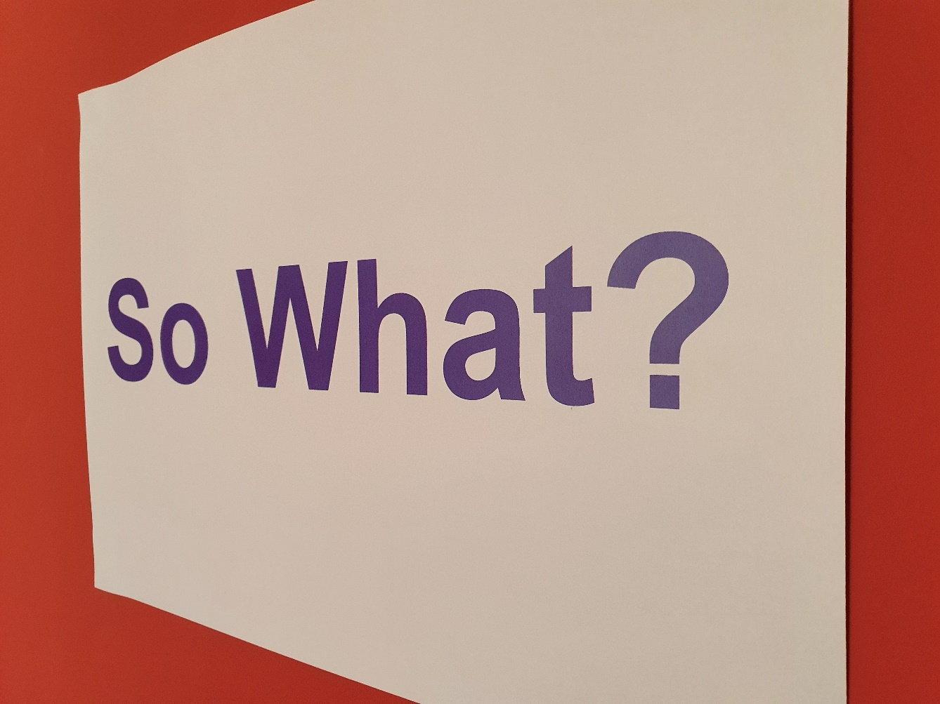
So What?
Notes:
So what you might ask
Like, but different to, an organisation’s mission or vision statement, the purpose of the organisation should motivate and direct people in the organisation in pursuit of a common goal;

Slide 29
So What? #2
Customer wants and desires
Worth doing
Hearts and minds
Noble
Notes:
it has been suggested that the questions required to “test” a purpose are:
Does the purpose reflect customer wants and desires?
Is what the purpose suggests worth doing?
Does the purpose reach for the hearts and minds of people who work for the organisation?
Is the purpose noble and does it serve the public?
Sadly, very few companies develop a purpose which meet these criteria so, by default, they don’t have a purpose which aligns the effort of people to the organisational activities... As a result, it could be argued, very few companies will achieve their full potential.
The second reason for articulating your company’s purpose is to encourage innovation.

Slide 30
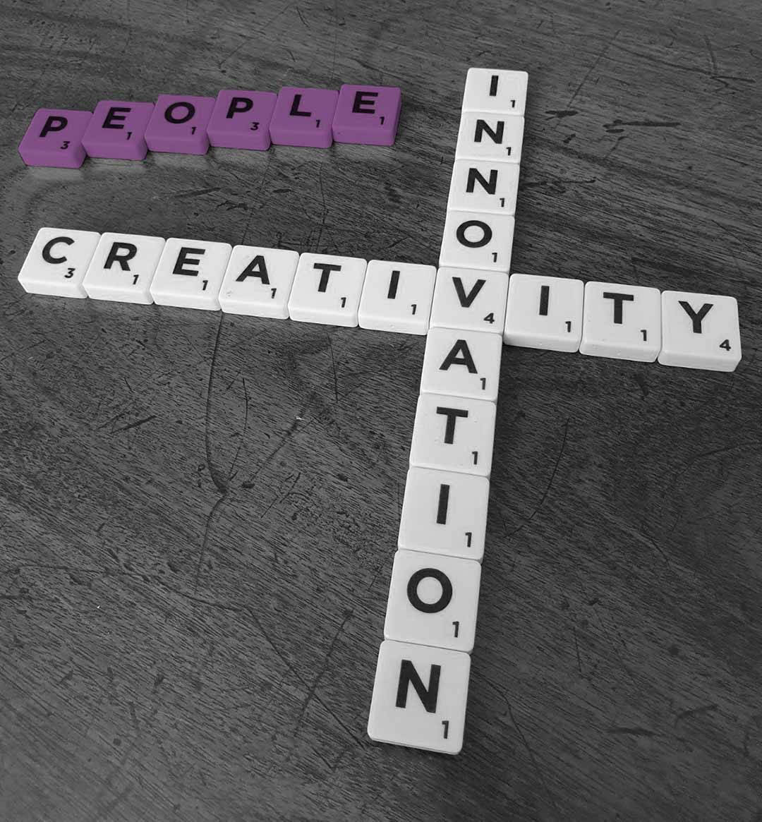
So What? #3
1) Drive innovation
2) Navigate displacement technology shifts
Notes:
A recent McKinsey reports that many manufacturers are still 10 year behind in the digital transformation ....and people are our only source of creativity and innovation... And innovation is critical to long-term prosperity and...
So... if you are focused on the benefits of and capabilities delivered to your clients
1. you can actively engage your people in innovation, which is just a fancy word for the activities that seek to find better ways of delivering those benefits and capabilities .... to your clients
2. ... And ... given that there are a whole bunch of displacement technologies coming … 3D printing, additive manufacturing, batteries, water batteries, sand batteries, industry 4... unlike Kodak and Blockbuster, you’ll know it’s time to change track.
Once you have your WHY the next question is HOW will you go about developing this stuff?

Slide 31
So where do you start?
Create a team
Study
Mull the question over
Create notes
Throw out your ideas and discuss them
Shortlist
Regroup and read aloud
Refine and repeat
Let it settle
Notes:
There is no one right way to do this. While there are some guidelines, every company has its own story .…but a process that seems to work is:
Create a team …but initially work individually…
Study (think hard ... don’t simply review what you do and who you do it for ... but really study what, why, how and who you do it for )
Mull the questions over … what should our mission be... What is our Vision and our Purpose .... what are our values?
Jot your ideas down
Throw out your ideas and discuss them …ask staff, clients, suppliers, family, friends
Shortlist … your individual ideas for group discussion
Regroup as a team and read aloud what you’ve got so far
Then it’s a case of refine and repeat
Finallily ... Let it settle …sit on our list for a few months and refine again
And, there are some questions that might be useful to guide you

Slide 32
Questions
Will we still believe this in 5 years? 10 years?
Are these something that we are willing to hire on?
Are these something that we are willing to fire on?
Notes:
…there are others in the “how to” document you’ll be sent following the webinar:
Incidentally, the “how to” takes you though this process with examples and exercises to undertake both individually and as part of a team
So, …it includes these and other questions
Is this something that’s likely to be long lived… will we still believe it in 5 years? 10 years?
Is this something that we are willing to hire on?
Perhaps more critically, is it something that we are willing to fire on?

Slide 33
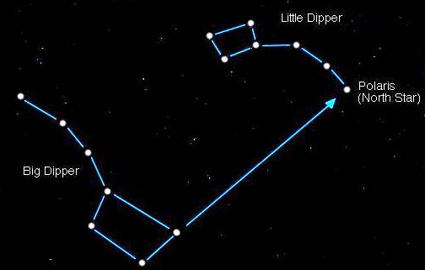
Your North Star
Notes:
What we are looking to do is create a small number of powerful mission, vision, values and purpose statements that, taken together, become your North Star… your guiding light
Any crisis will bring a nations… or a company’s … values to the fore, stress levels are raised, processes falter, attention is diverted … you need a guiding light
The Corona Crunch and the cost of living crisis provides an opportunity, and a trigger, for construction companies to ground themselves in their purpose — that is, to focus intensely on the core questions:

Slide 34
Your North Star
Why do we exist?
Why are we here?
Whose needs are we here to meet?
Notes:
Why do we exist? ....Why are we here? Most critically …Whose needs are we here to meet?
Leadership plays a critical role in answering these questions and, more importantly, in delivering on the promise inherent in them
People …and not just millennials… want to work for companies with missions and business philosophies that resonate with them intellectually and emotionally
We fundamentally believe that the core question any organization must answer when communicating its purpose starts with its customers: That is, what are the needs that the company is being paid to meet?
Considering the challenges facing companies right now (manufacturing— including boosting the production of vital goods at a time of duress and stress — alignment between employee purpose and organizational purpose is crucial. Employees need to see why they should continue to show up to work amid such difficult circumstances
For centuries, theologians and philosophers have told us that seeking meaning is central to human experience…so it should actually be no surprise at all that Sinek’s TED talk …start with Why… is the third-most-watched TED Talk of all time.

Slide 35
Your North Star
Notes:
The events of today and the last few years have plunged many companies into a big and unsuspecting hole, we may be uncertain, our people may be uncertain so ...
… we are going to need to
Continue to reassure some of our battered and fragile people
Rescue and re-engage some of our customers
Resurrect our finances, rebuild our balance sheets and pay off bank loans … but your people don’t care about that

Slide 36
Your North Star
Notes:
Staff are motivated to do their best work because of the role the company plays overall, not because it maximizes the wealth of a few directors, or in the case of quoted companies often thousands of nameless shareholders.
If you get this right they will …and they will want to …care about doing a good job for your customers
Give them a North Star to aim at
Give them framework to behave within and
Unleash their potential
Like Churchill and Kennedy before us and Zelensky now ....we can galvanise and inspire our troops to help us help others and restore the battered fabric of the construction sector.

Slide 37
Lets talk
I’ll take it from here
Let me know about future events
Notes:
... you’ll be sent an email shortly with access to the slide deck and our resources document which details all sorts of templates, examples, questionnaires that we can make available .... at the drop of a hat ... around a variety of issues... have a look through it if you need anything before the next webinar let us know...
So …whats next?
It could be you want to talk ... Lets agree a time for a video or phone call – either as a one to one or a conference call
You might like to take it from here on your own
You might simply want to know about future webinars
But the first port of call is probably the download...

Slide 38
Mark Woods - mwoods@statius.co.uk - 020 8460 3345
Notes:
As a reminder .... our purpose .... is to help you deliver ... better strategies ...better systems .... better measurement and engaged people delivering the all important .... better results ...
one final word thanks... I’d also like to extend my appreciation to the sponsors …. ….Jarrovian Wealth .... Independent financial advisors specialising in owner managers …. Good people to talk to …
Thank you for listening I hope it’s been helpful.

